Slide 1

POSTOPERATIVE MANAGEMENT

Slide 2
POSTOPERATIVE MANAGEMENT
After completion of surgery, patient was shifted to the RICU for postoperative management
Patient Condition after shifting to RICU:
Patient was conscious/coherent
PR - 96 bpm
BP - 100/60
SPO₂ - 97% with 4L of O₂
RS - Bilateral Air entry present
CVS - S1 S2 heard

Slide 3
POSTOPERATIVE MANAGEMENT
It is very important, especially in morbidly Obese patients
POSITION
OXYGENATION
POSTOPERATIVE MANAGEMENT
ANALGESIA
PREVENTION OF COMPLICATIONS
ANTITHROMBOSIS

Slide 4
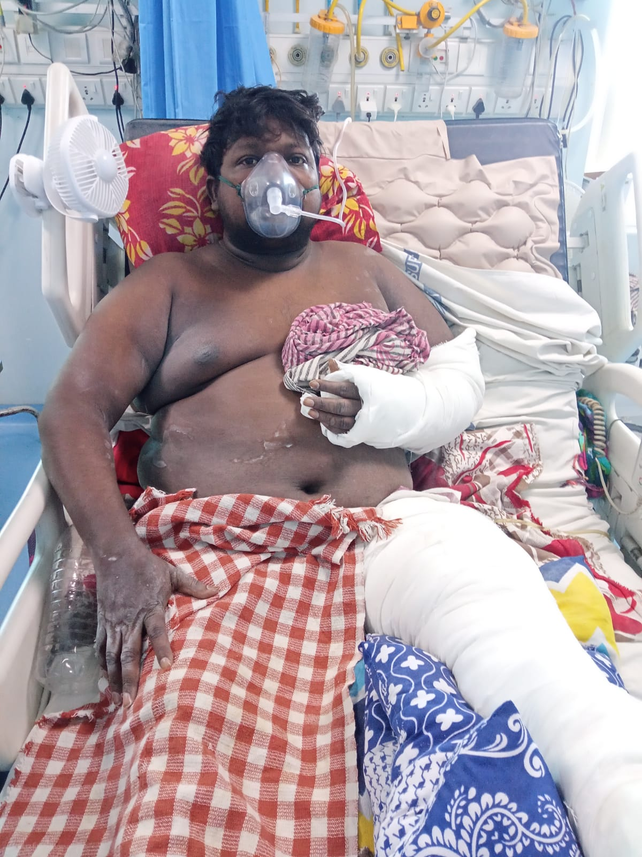
POSITION
Sitting / semirecumbent position

Slide 5
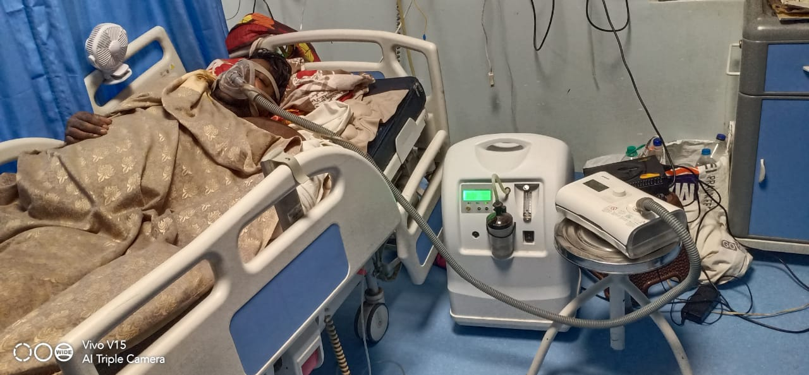
OXYGENATION
CPAP

Slide 6
ANALGESIA
Multimodal analgesia
Regional Analgesia

Slide 7
ANTITHROMBOSIS
Low molecular weight heparin (LMWH) Prophylactic dose started in next day morning
Tab. Apixaban

Slide 8
PREVENTION OF COMPLICATIONS
Early mobilization
Compression Stockings

Slide 9
Conclusion
Regional anesthetic techniques should be considered to reduce or eliminate the requirements for systemic opioids in patients with OSA. If neuraxial anesthesia is planned, the benefits and risks of using an opioid or opioid-local anesthetic mixture as compared to local anesthetic alone must be considered.
If patient-controlled systemic opioids are used, continuous background infusions should be avoided or used with extreme caution. Nonsteroidal anti-inflammatory agents and other modalities should be considered to reduce opioid requirements.
Supplemental oxygen should be administered continuously to all patients who are at increased perioperative risk from OSA until they are able to maintain their baseline oxygen saturation while breathing room air.
Hospitalized patients at increased risk of respiratory compromise from OSA should be monitored with continuous pulse oximetry after discharge from the recovery room.

Slide 10
THANK YOU

